Slide 1
How does carbon sequestration from natural forest regrowth differ around the world?
Notes:
Ask students for input and predictions (not necessarily hypotheses yet)

Slide 2
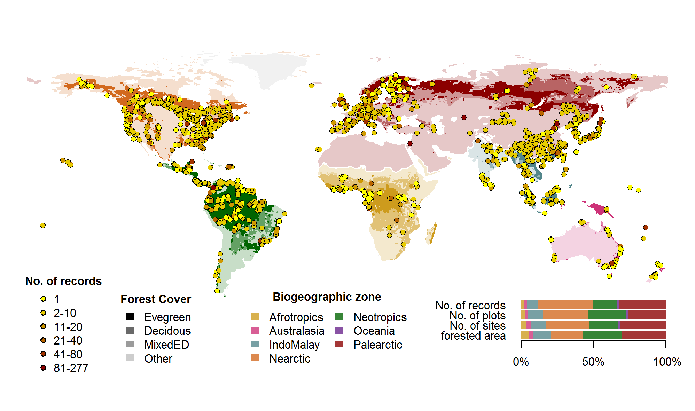
ForC Records
Notes:
This contains the ForC databases from around the world. Students will be working with data from different locations (https://forc-db.github.io/)

Slide 3
A Year in the Life of Earth’s CO2
Before the video begins predict what will happen to Earth’s carbon dioxide concentrations over the course of a year.
What happens to the carbon dioxide emitted from fossil fuel combustion? Where does it go?
Watch the video carefully and write down quick notes on what you’re seeing as the year progresses. Note months with high and low concentrations. Write down as many observations as you can. Be sure to write down any major changes or anything you hear that is surprising.
What is happening to the concentrations of carbon dioxide in the air?
Notes:
https://svs.gsfc.nasa.gov/cgi-bin/details.cgi?aid=11719
This is an opportunity to discuss carbon sequestration and climate change. Questions go along with the video

Slide 4
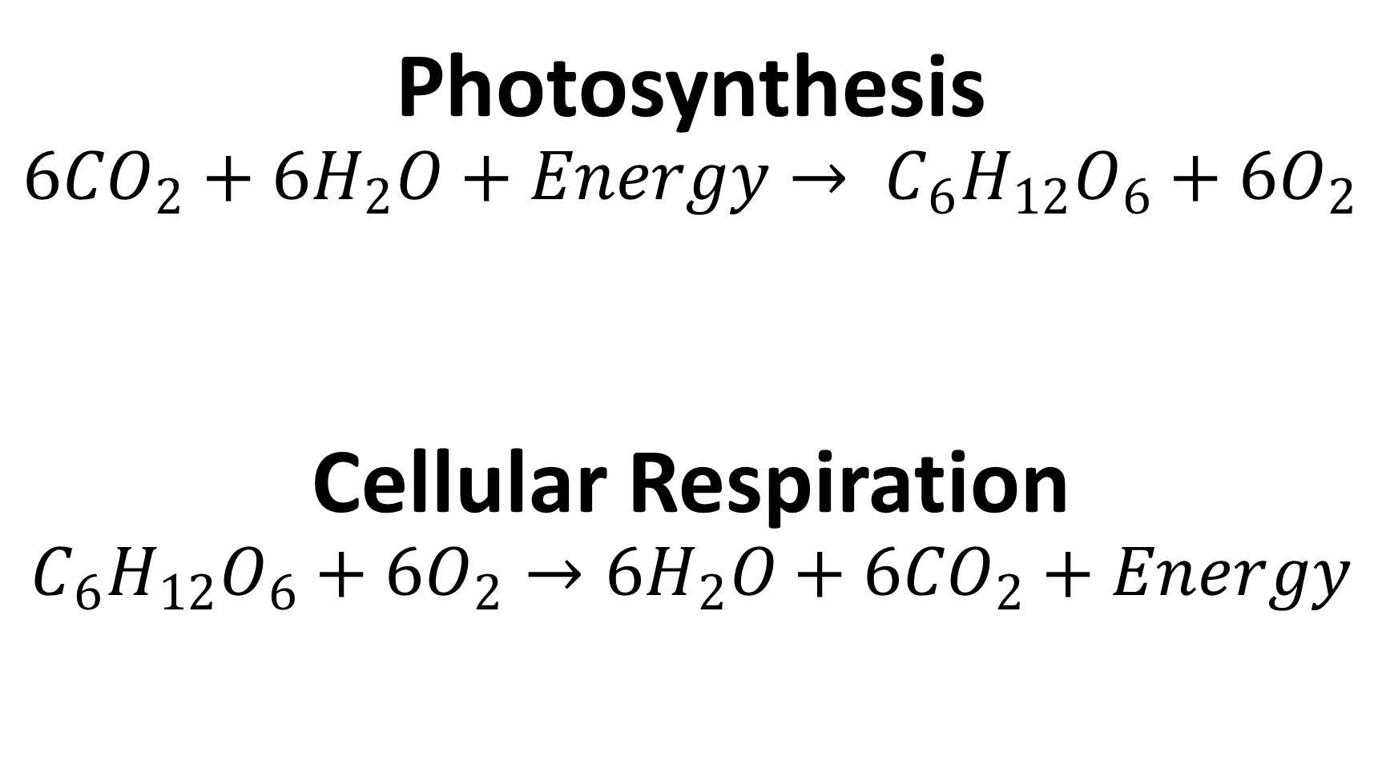
Photosynthesis
$$6{CO}_{2}+{6H}_{2}O+Energy→ C_{6}H_{12}O_{6}+6O_{2}$$
Cellular Respiration
$$C_{6}H_{12}O_{6}+6O_{2}→{6H}_{2}O+6{CO}_{2}+Energy$$
Notes:
Review the formulas for photosynthesis and cellular respiration, make sure to discuss their connections

Slide 5

Biological Carbon Cycle
Carbon enters all food webs, both terrestrial and aquatic, through autotrophs (usually through photosynthesis)
Heterotrophs consume the organic molecules, and the organic carbon is passed through food chains and webs.
Carbon is released back into the atmosphere through cellular respiration
Producers, Consumers, Decomposers
Notes:
Carbon can cycle quickly through this biological pathway, especially in aquatic ecosystems. Overall, an estimated 1,000 to 100,000 million metric tons of carbon move through the biological pathway each year. For context, a metric ton is about the weight of an elephant or a small car
(photo - https://commons.wikimedia.org/wiki/File:Giant_Panda_Eating.jpg, by Chen Wu from Shanghai, China)

Slide 6
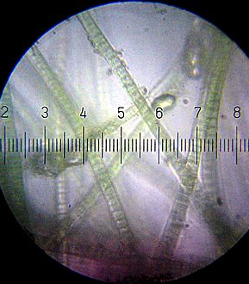
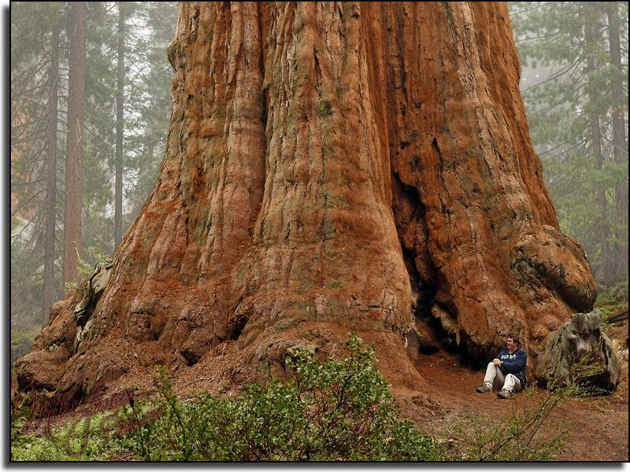
Carbon fixation: the conversion of inorganic carbon (carbon dioxide) to organic compounds by living organisms
Carbon sequestration: a natural or artificial process where carbon dioxide is removed from the atmosphere and held in solid or liquid form.
Notes:
Photos courtesy of Wikipedia commons, basic difference between carbon fixation (the algae) and carbon sequestration (the giant redwood)

Slide 7
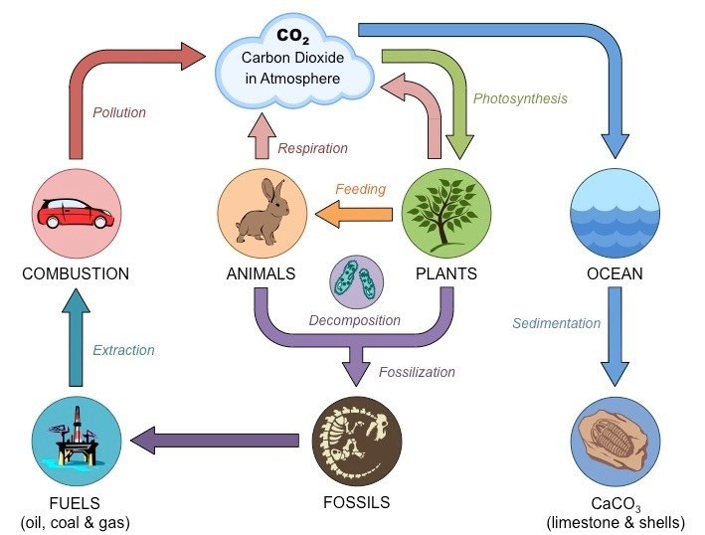
Notes:
Ask for input on the carbon cycle, review the basic process of global warming (where Carbon Dioxide in the atmosphere traps heat causing the global temperature to rise)
(photo credit - https://www.noaa.gov/education/resource-collections/climate/carbon-cycle)

Slide 8
Notes:
This shows fluctuations in carbon stocks. Note that most carbon is cycled through the forest and a small percentage overall is actually put into the forest sink. A negative number means carbon is being pulled from the atmosphere and a positive number means it’s being released.
(photo credit – painting by Kristina Anderson-Teixeira, text by Valentine Hermann)

Slide 9
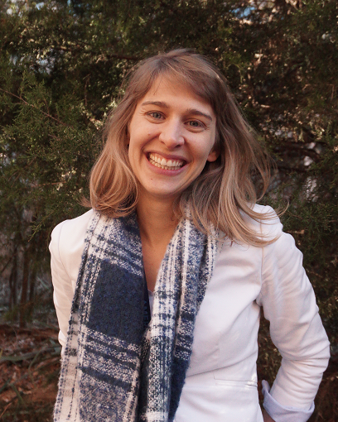
Dr. Susan Cook-Patton
She studies the importance of plant diversity and how changes in climate and biodiversity impact the health of natural and urban ecosystems.
She is a forest restoration scientist for The Nature Conservancy

Slide 10
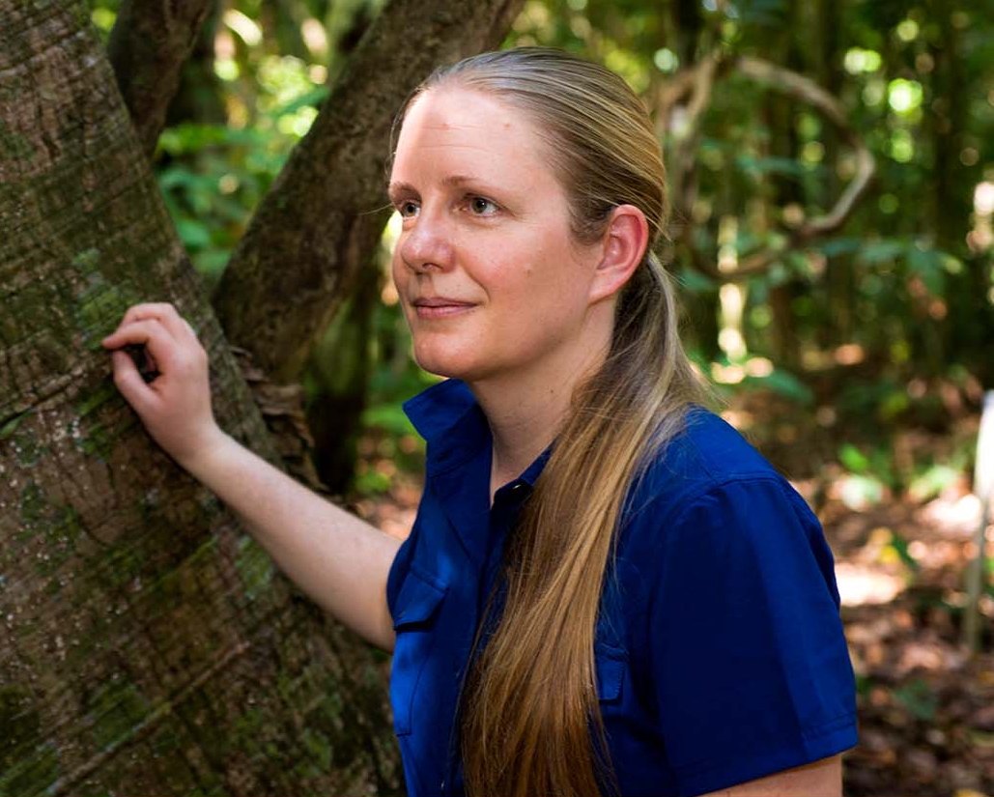
Dr. Kristina Anderson-Teixeira
She studies forest ecosystem ecology, global change ecology, and climate protection through forest conservation.
She leads the Ecosystems & Climate Research Initiative for the Center for Tropical Forest Science-Forest Global Earth Observatory (CTFS-ForestGEO),

Slide 11
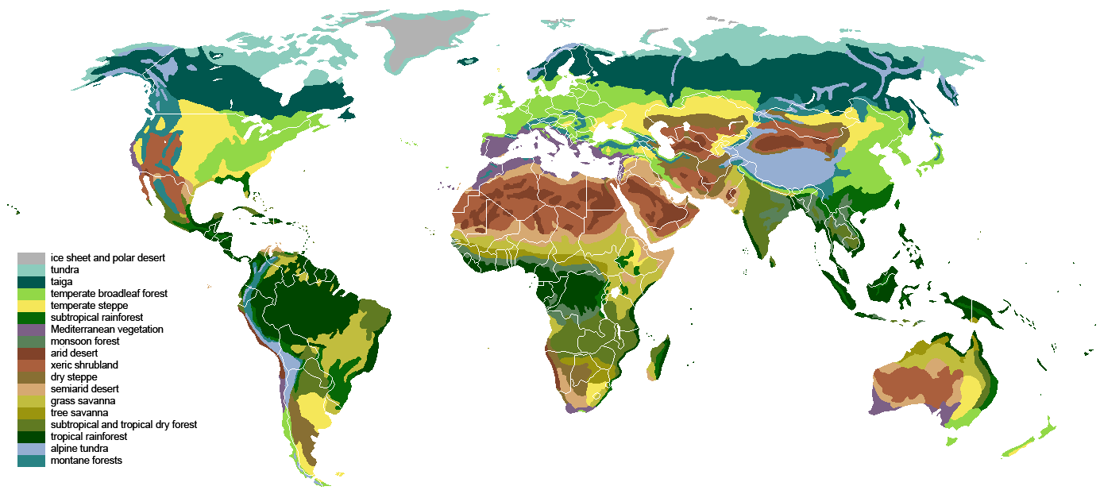
Biome: A distinct community of plants and animals occupying a specific environment
Notes:
Biomes around the world, photo credit Ville Koistinen, Wikipedia commons https://commons.wikimedia.org/wiki/File:Vegetation.png. Though there are many biomes, our study focuses on four: Boreal forests, Temperate forests, Subtropical forests, and Tropical forests

Slide 12
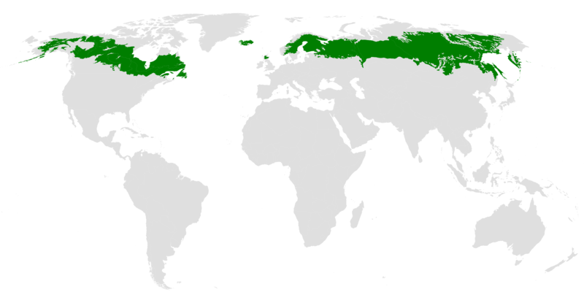
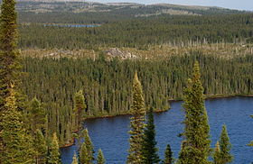
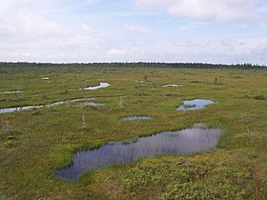
Boreal Forest
Found only in the Northern Hemisphere
Forest is comprised mostly of conifers such as spruce, jack pine, tamarack, and fir along some deciduous trees
Temperatures are generally cool and drop considerably in the winter
Notes:
Photo credits: Wikipedia Commons https://upload.wikimedia.org/wikipedia/commons/thumb/5/5d/Taiga_ecoregion.png/800px-Taiga_ecoregion.png

Slide 13
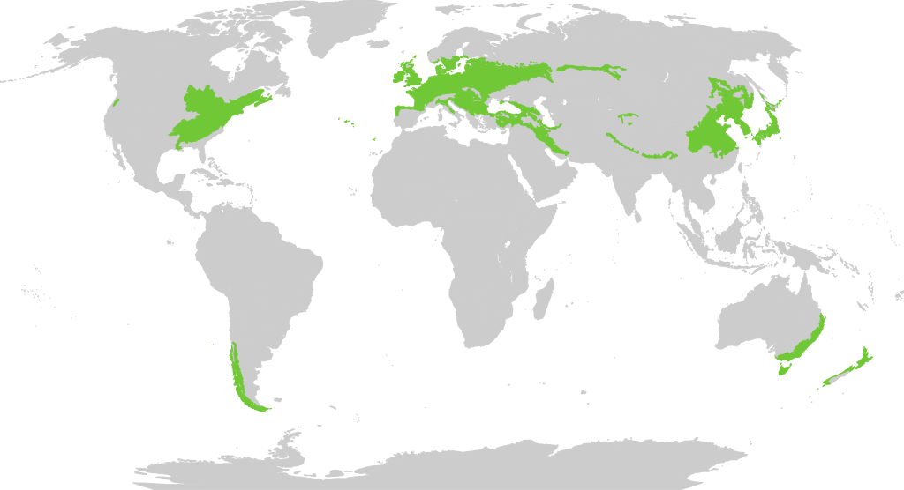
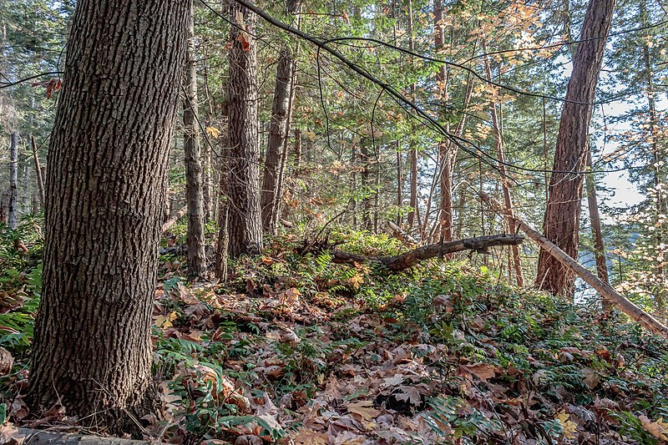
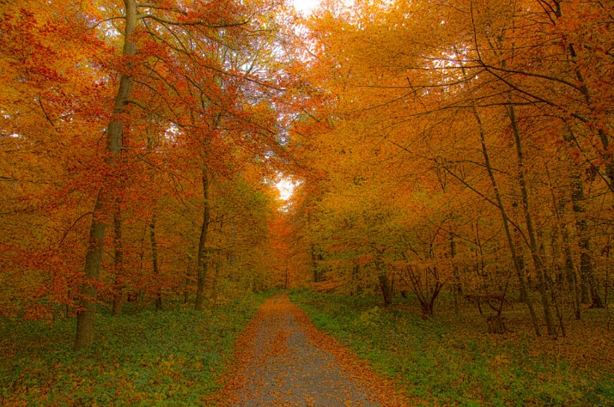
Temperate Forest
Found in both the Norther and Southern Hemisphere
Forest is comprised mostly of deciduous trees and conifers
Temperatures vary throughout the seasons with warm summers and cold winters
Notes:
Photo credits: By Terpsichores - Own work, CC BY-SA 3.0, https://commons.wikimedia.org/w/index.php?curid=22441317
By Norbert Nagel, Mörfelden-Walldorf, Germany - Own work, CC BY-SA 3.0, https://commons.wikimedia.org/w/index.php?curid=17255800

Slide 14
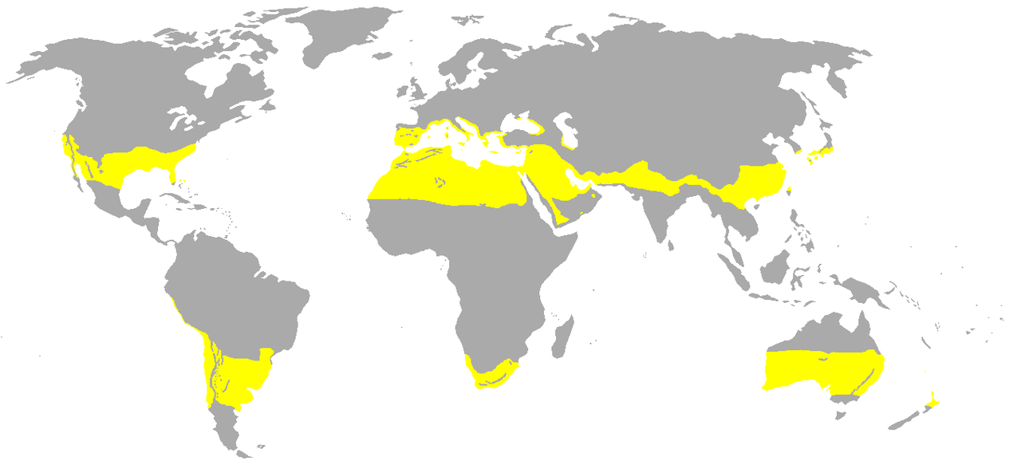
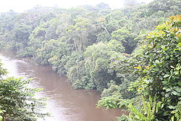
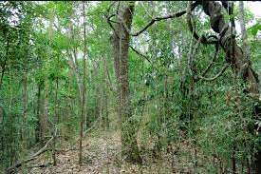
Subtropical Forest
Found between the temperate and rainforest zone
Forest is comprised mostly of deciduous trees
Temperatures are generally warm and stable, rainfall varies seasonally
Notes:
Photo credit: By Maphobbyist - Own work, CC BY-SA 3.0, https://commons.wikimedia.org/w/index.php?curid=14504468

Slide 15
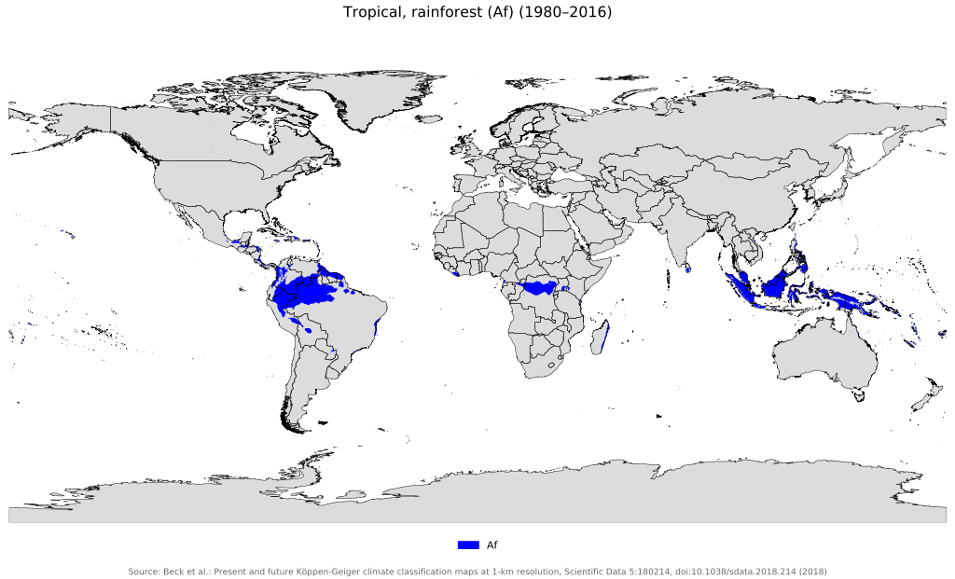
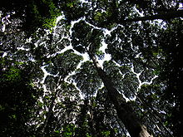
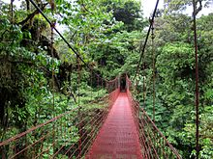
Tropical Forest
Found around the equator and some higher elevations
Forest is a unique mixture of deciduous trees
Temperatures are generally stable throughout the year and rainfall is consistently high
Notes:
Photo credits: By Beck, H.E., Zimmermann, N. E., McVicar, T. R., Vergopolan, N., Berg, A., &amp; Wood, E. F. - &quot;Present and future Köppen-Geiger climate classification maps at 1-km resolution&quot;. Nature Scientific Data. DOI:10.1038/sdata.2018.214., CC BY 4.0, https://commons.wikimedia.org/w/index.php?curid=74672913

Slide 16
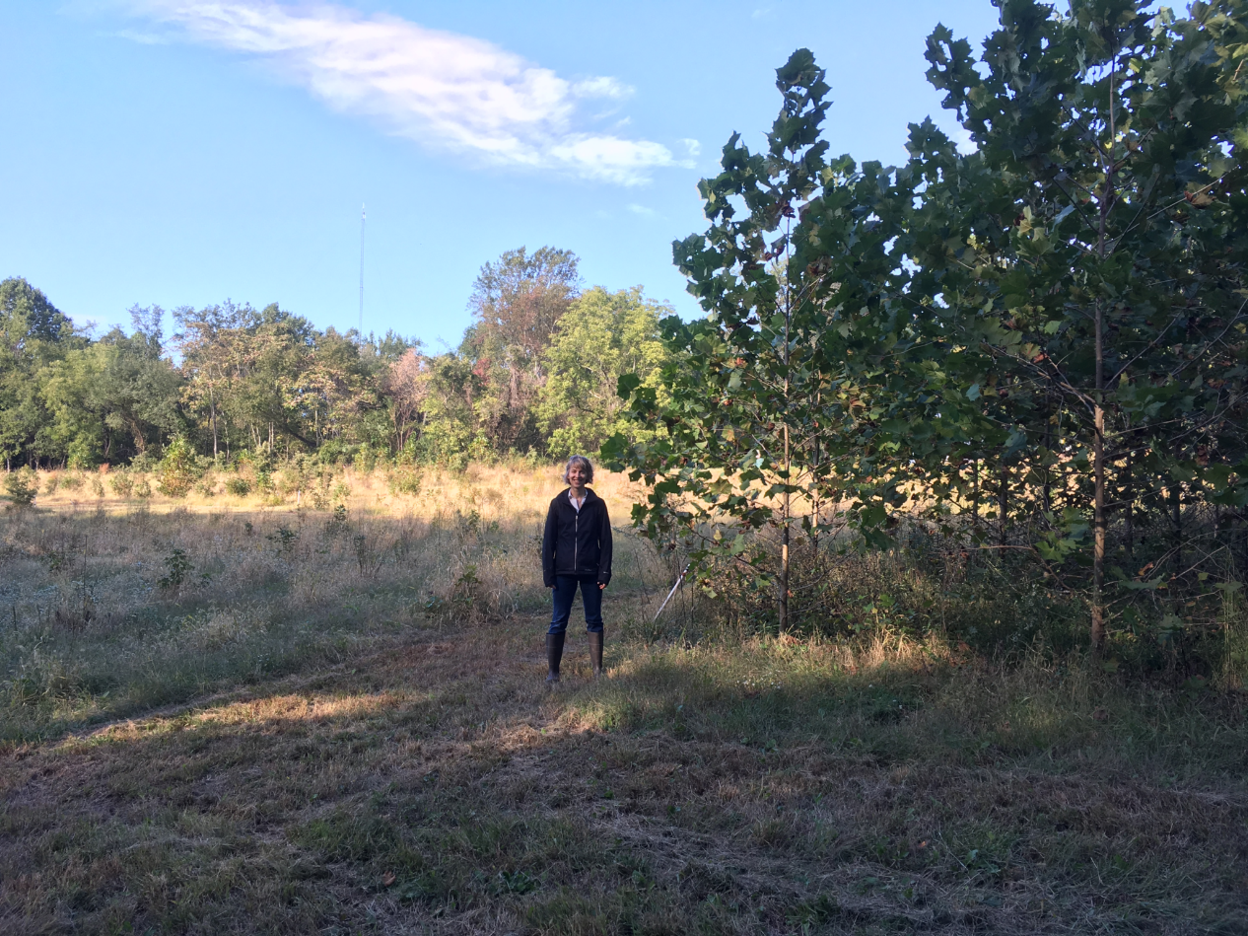
Forest Regrowth
The natural regrowth process of previously cleared land back into forests
This method is similar to reforestation, but relies considerably less on human actors
Notes:
Photo: Dr. Susan Cook-Patton stands in the Biodiversitree reforestation experiment in the Chesapeake Bay watershed.

Slide 17
ForC Records
Notes:
This contains the ForC databases from around the world. Students will be working with data from different locations (https://forc-db.github.io/)

Slide 18
ForC: The Forest Carbon database
ForC is an open-access database containing over 30,000 records from 5,000 plots in 3,325 geographically distinct areas.
All data in ForC comes from published research by accredited scientists.
This database covers all forested biogeographic and climate zones
ForC can be used for ecological analysis of forest carbon cycling, evaluating models and remote sensing, and supporting international efforst to inventory forest carbon and greenhouse gas exchange.

Slide 19


Intergovernmental Panel on Climate Change
The IPCC is an intergovernmental body of the United Nations established in 1988
Its primary purpose is to provide objective information relevant to human-induced climate change.
Includes: Research, Policy Recommendations, Economic Impacts, Risks, Possible Response options, etc.
Part of our objective is to evaluate the accuracy of the IPCC’s estimate of Forest Regrowth
Notes:
Slides on IPCC

Slide 20
Hypotheses
H1: What forest type (boreal, temperate, subtropical, or tropical) accumulates the most carbon during natural regrowth?
H2: How accurate are the IPCC estimates of forest carbon accumulation during natural regrowth for each forest type?
Notes:
Slides on forest regrowth

Slide 21
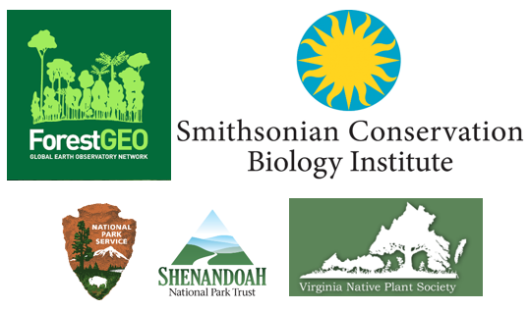
Acknowledgements
ForC Data Nugget Author: Ryan Helcoski
In addition, we would like to thank the following organizations for providing funding to make this endeavor possible

